Slide 1
DATA MINING
FINAL PROJECT
By: Brianna Floyd, Deric Woo, and Anastasia Lomtadze
Notes:
Brianna

Slide 2
AGENDA
First Glance at the Data
Data Cleaning
Queries and Visualizations
Linear Models
Conclusion
Notes:
Anastasia

Slide 3
FIRST GLANCE AT THE DATA
Notes:
Anastasia

Slide 4
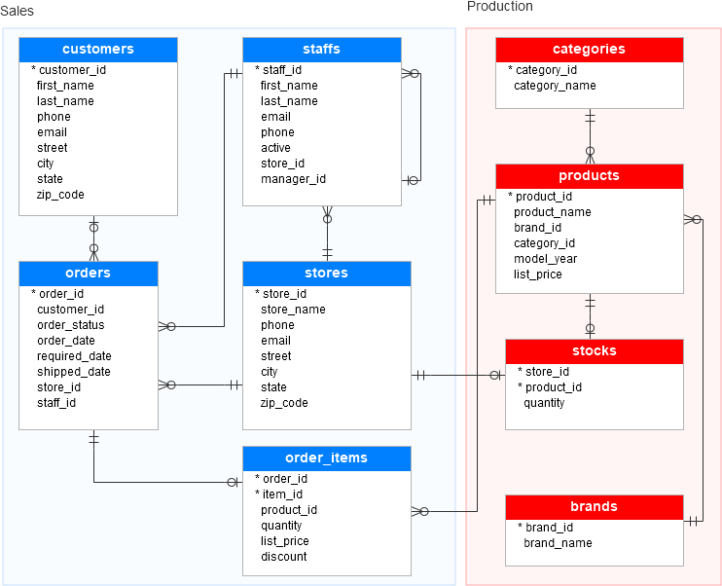
3rd normal form
Notes:
Anastasia (mention that our data is in 3rd normal form)

Slide 5
DATA CLEANING
Notes:
Anastasia

Slide 6
Nulls
Formatting
Surprisingly, we had no nulls in our dataset. What we did have were some observations in shipped_date that were listed as “NULL” (as a string) but we investigated and found that these were all correct, because they were part of orders that had not yet been shipped.
What we focused on instead of cleaning nulls, was ensuring that all our columns were formatted correctly, with good titles, good names for each csv file, and TIDY data.
Notes:
Anastasia (mention what TIDY data is)

Slide 7
QUERIES 1 AND 2
170
0
Notes:
Brianna

Slide 8
QUERIES AND VISUALIZATIONS
Notes:
Brianna

Slide 9
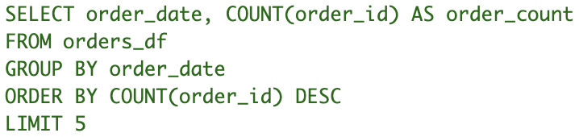
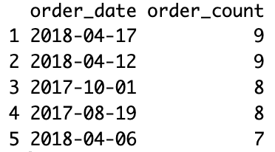
QUERY 3
Notes:
Brianna

Slide 10
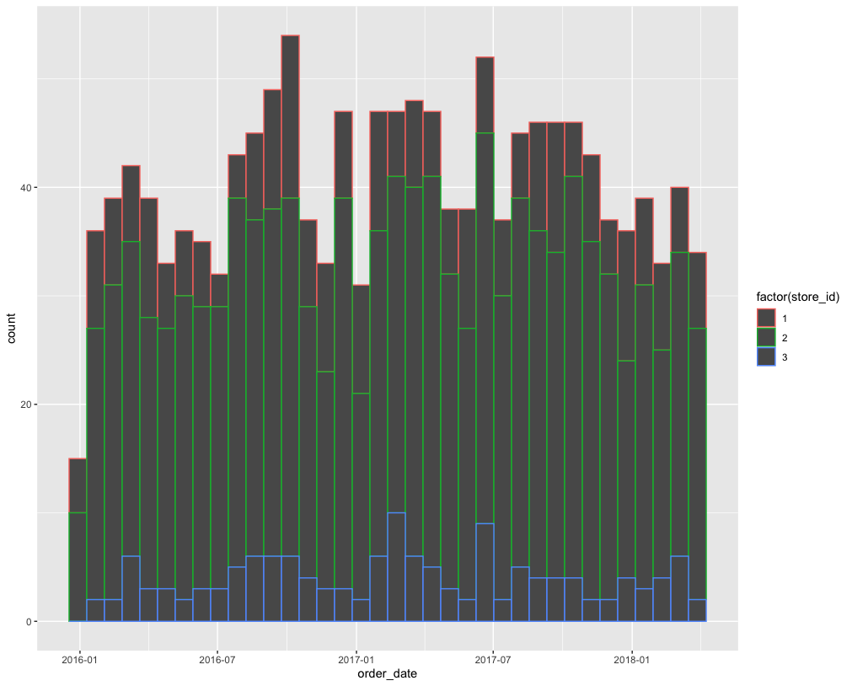
VISUALIZATION 1
Notes:
Brianna (mention use of color in all our graphs)
This graph provides histograms measuring the number of orders received colored by each store id.
We used 36 bins, for the months in three years.

Slide 11
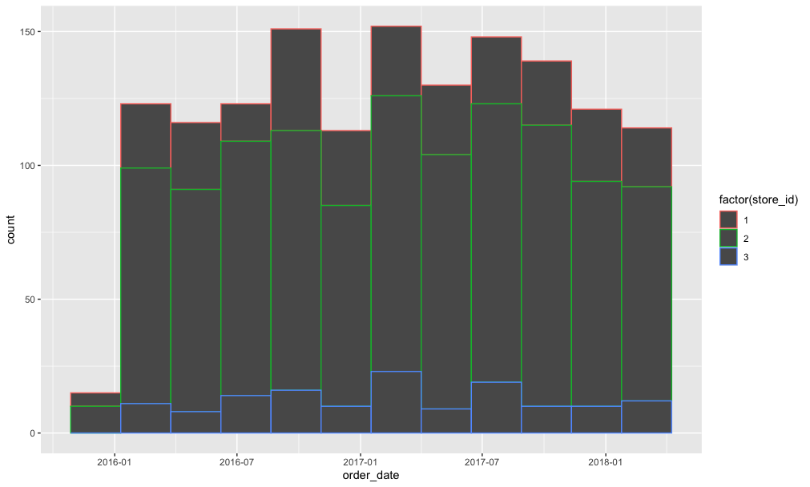
VISUALIZATION 2
Notes:
Brianna
This graph is the same as the previous one, only this time, we used 12 bins, for the quarters in three years.
It appeared visually more normal this way, which leads us to believe the data is not so inconsistent.

Slide 12

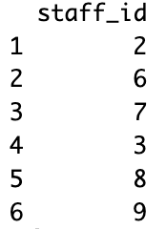
QUERY 4
Notes:
Brianna

Slide 13
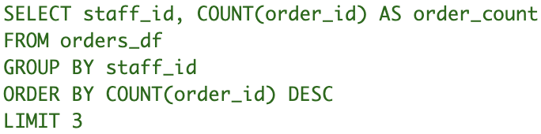
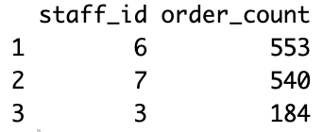
QUERY 5
Notes:
Brianna

Slide 14
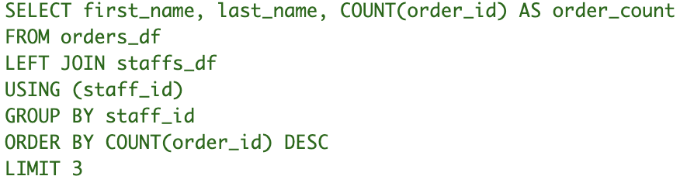
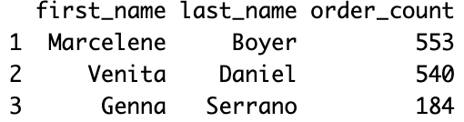
QUERY 6
Notes:
Brianna

Slide 15
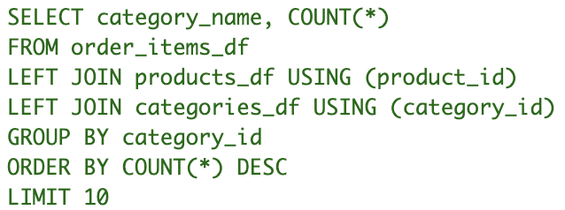
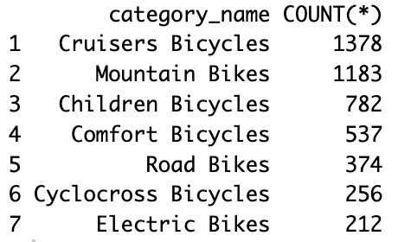
QUERY 7
Notes:
Brianna

Slide 16
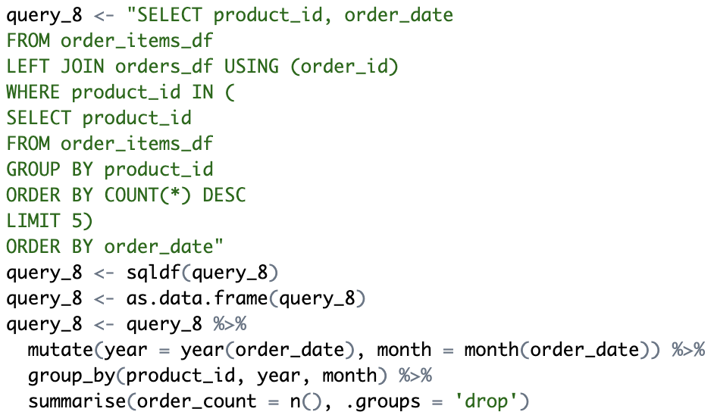
QUERY 8
Notes:
Anastasia

Slide 17
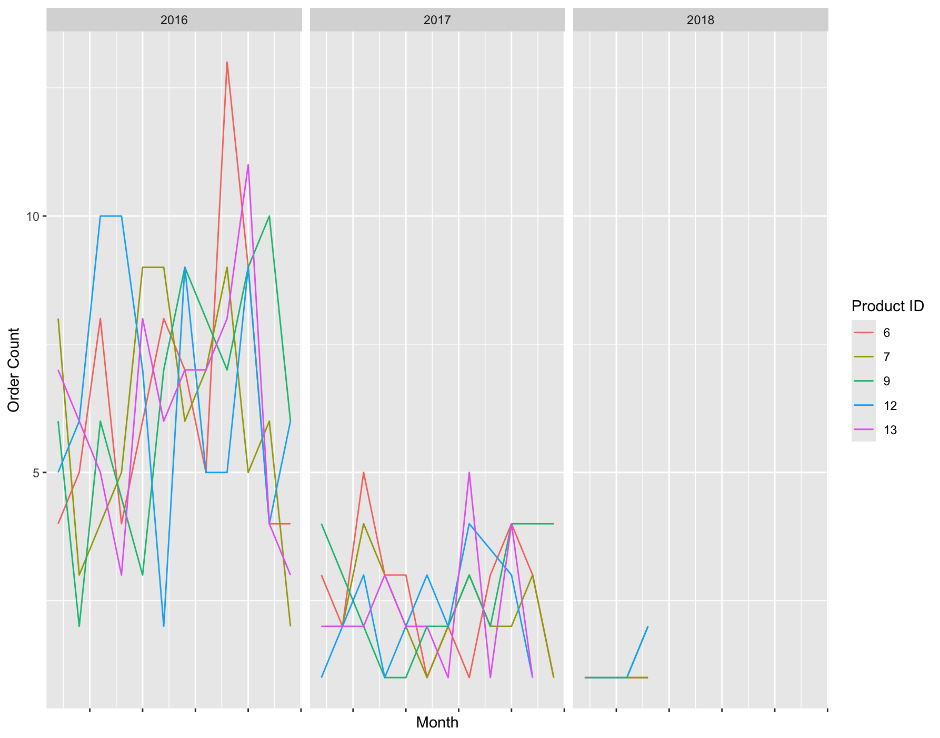
VISUALIZATION 3
Notes:
Anastasia (mention use of facet wrapping for Year)
This visualization is based off of Query 8 and it depicts the number of orders received over time by product only for the top 5 products (top meaning most orders received).

Slide 18
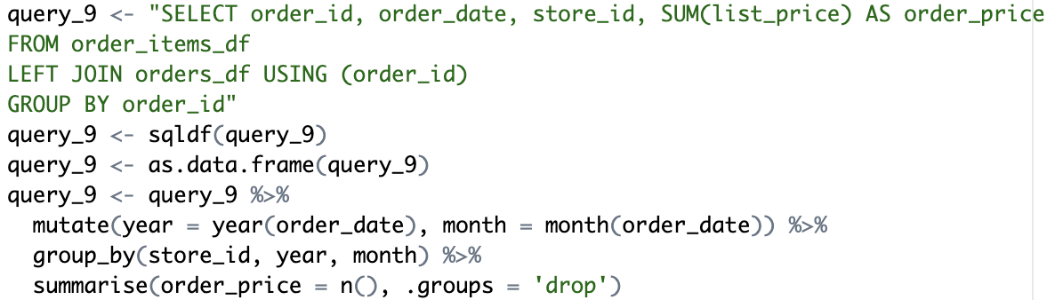
QUERY 9
Notes:
Anastasia

Slide 19
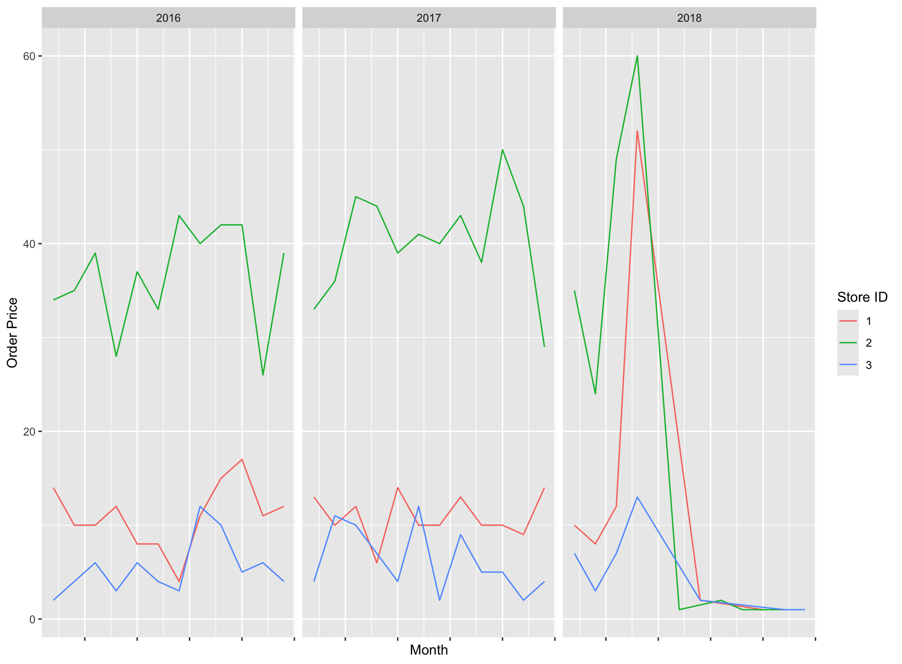
VISUALIZATION 4
Notes:
Anastasia
The visualization above is based on Query 9 and shows the average order price over time. Color differentiates the store id.

Slide 20
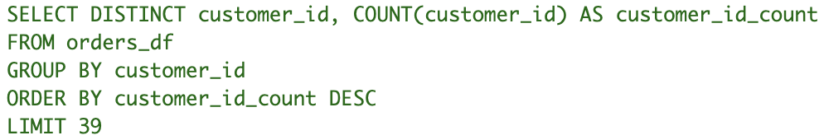
QUERY 10
Notes:
Deric

Slide 21

QUERY 11
Notes:
Deric

Slide 22
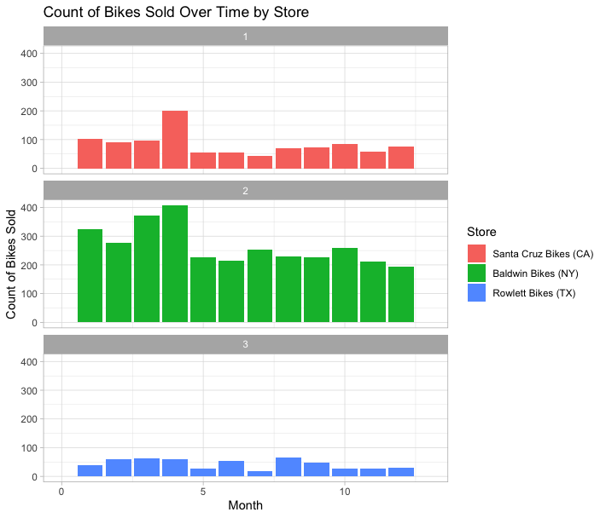
VISUALIZATION 5
Notes:
Deric (mention that this graph aggregates the months between years)
Taking a look at the graph above, which is generated from Query 11, we’re taking a look at the count of bikes sold over time by each store. There are only three stores to take a look at: one in California, one in New York, and one in Texas. In graphs one and two, there seems to be a bit of a positive skew, showing that bikes are more popular in the earlier months in the year. For graph number three, the count of bikes sold is much lower in Texas in comparison to the other two. New York is significantly higher than both of the other states, showing much more popularity than the two in bikes sold. They have a high of a little over 400, whereas California has a high of roughly 200, and Texas has a high of somewhere merely over 50.

Slide 23
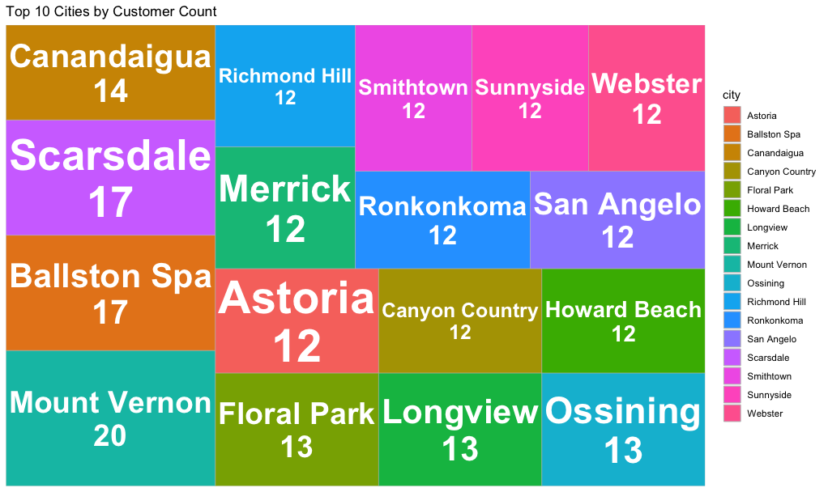
VISUALIZATION 6
Notes:
Anastasia
This visualization above is a treemap which displays the top 10 cities with the highest customer counts. The data is grouped by the city column, and the total number of customers in each city is calculated using the summarize() function. The cities are then sorted in descending order based on their customer counts.
The treemap, created using ggplot2, shows rectangles with different sizes corresponding to the number of customers in a city. The larger rectangles indicate higher customer counts, with each rectangle being filled in distinct colors and labeled. For instance, Mount Vernon counts the highest number of customers, highlighting its prominence among top cities.

Slide 24
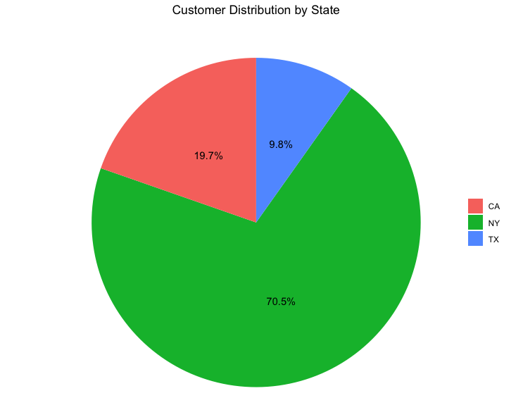
VISUALIZATION 7
Notes:
Anastasia
This graph above visualizes the distribution of customers by state using a pie chart. After grouping the data by state and calculating the total number of customers for each state, the date is then sorted in descending order to identify states with the largest customer density.
Each slice of the pie represents a state, with the size proportional to its customer count. The resulting visualization provides a clear representation of how customers are distributed across states, emphasizing New York as the dominating state, followed by California, and lastly, Texas.

Slide 25
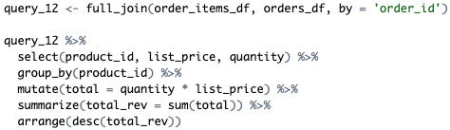
QUERY 12
Notes:
Deric

Slide 26
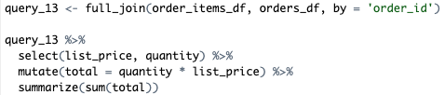
QUERY 13
Notes:
Deric

Slide 27
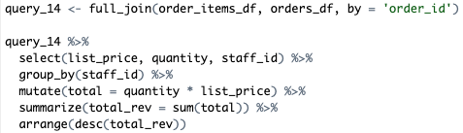
QUERY 14
Notes:
Deric (mention that it’s the same as Query 5, but for price instead of quantity)

Slide 28
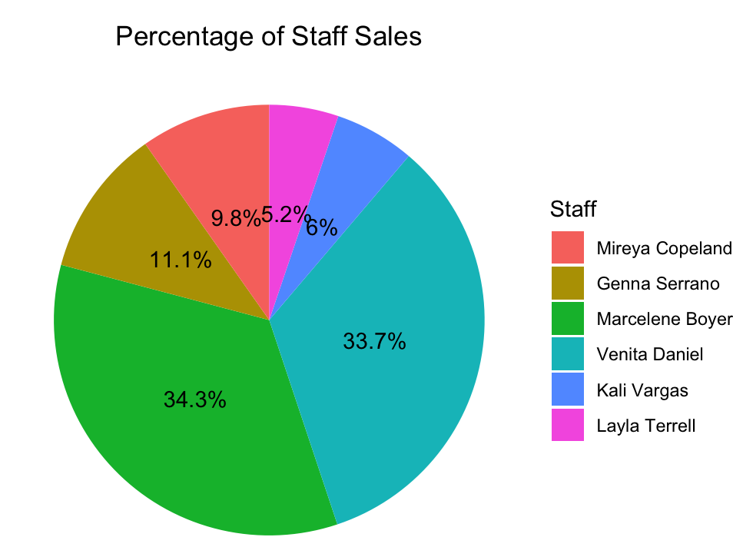
VISUALIZATION 8
Notes:
Deric
This visualization above builds on Query 14 to highlight the highest performing staff members. The percentages are in terms of contribution to total revenue.

Slide 29
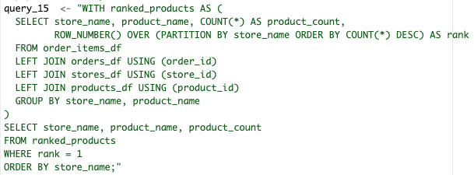
QUERY 15
Notes:
Brianna

Slide 30
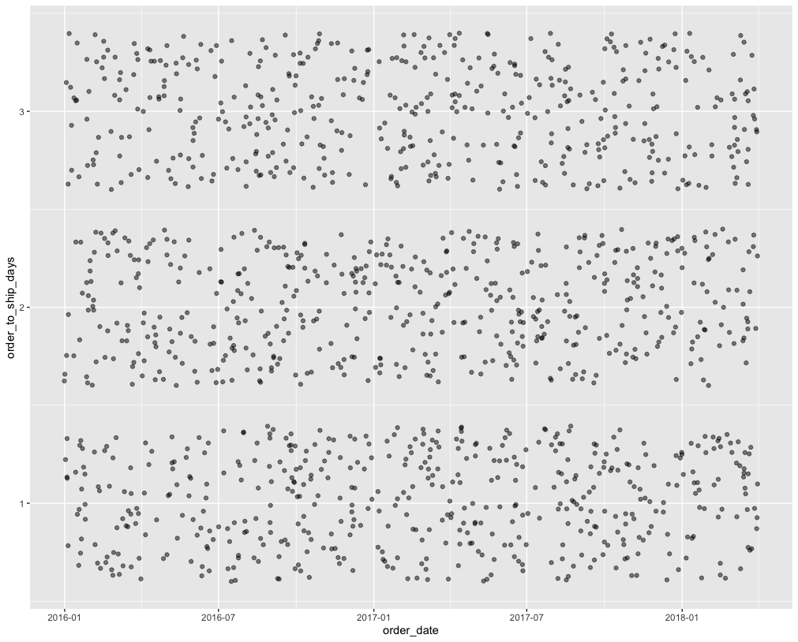
VISUALIZATION 9
Notes:
Brianna
The above graph showcases the distribution of the amount of time between an order being placed and the order being shipped. We used jitter and an alpha argument to make it so more of the points could be visible on the graph. The data points are clustered around the 1, 2, and 3 day areas, because we measure these dates in days, not hours or smaller. It’s good to know that no order took longer than 3 days after the order date to ship.

Slide 31

QUERY 16
Notes:
Brianna

Slide 32
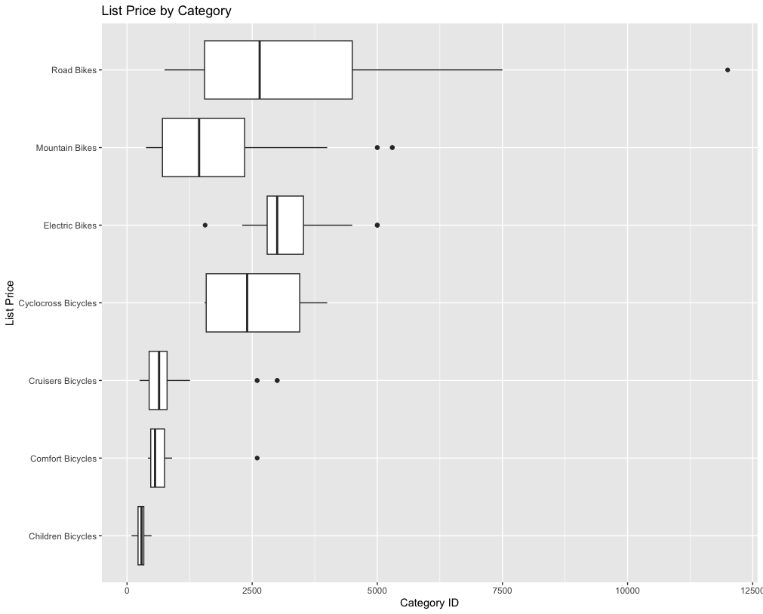
VISUALIZATION 10
Notes:
Brianna

Slide 33
LINEAR MODELS
Notes:
Brianna

Slide 34

QUERY 17
Notes:
Brianna

Slide 35
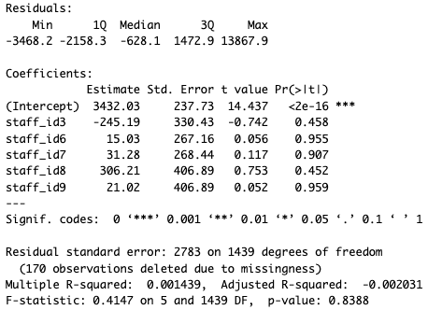
MODEL 1
Notes:
Brianna

Slide 36
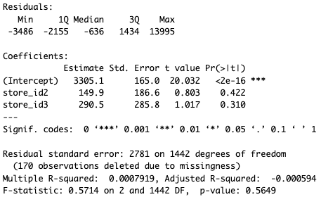
MODEL 2
Notes:
Brianna

Slide 37
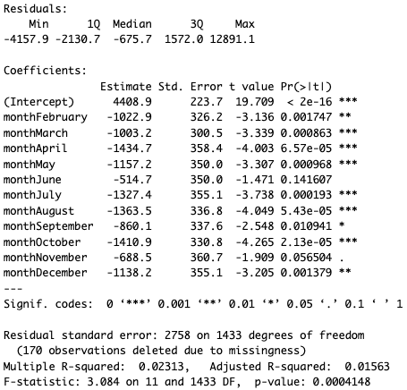
MODEL 3
Notes:
Brianna

Slide 38


CONCLUSION
Valuable insights:
Importance of including a variety of visualizations to identify trends in sales, store productivity, and staff performance
New York leads in bike sales
All orders were delivered within 3 days
Top-performing staff members
Learned the importance of data cleaning, code organization, and clear naming conventions
Notes:
Anastasia

Slide 39

IMPROVEMENTS
Incorporate external data
Provide deeper insights on sales patterns (weather or seasonal trends).
Address data gaps and Customer Behavior Analysis
Investigate customer demographics and preferences.
Enhanced visualizations
Use of interactive dashboards to better understand findings.
Notes:
Anastasia

Slide 40
THANK YOU
Notes:
Anastasia

